Slide 1



Feeding A Heterogeneous ICU Population:
What is the Evidence?
Daren K. Heyland
Professor of Medicine
Queen’s University, Kingston General Hospital
Kingston, ON Canada
Notes:
Add data from iatrogenic malnutrition slides

Slide 2
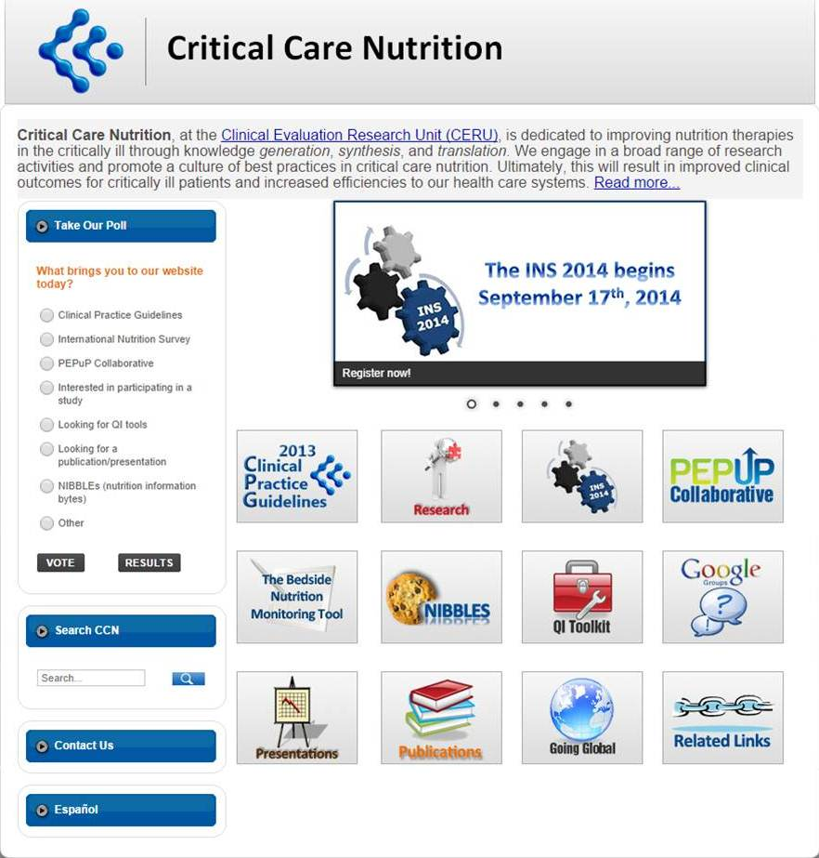

Slide 3
The First Controlled Clinical Trial
vs 5 | King appoints daily provision of King’s meat and wine to children of Israel
vs 8 | Daniel did not want to defile himself
vs 10 | Prince of Eunuchs did not want to get into trouble with the King
vs 12 | Prove thy servants, I beseech thee, ten day; and let them give us pulse to eat, and water to drink.
vs 13 | Then let our countenances be looked upon before thee and the countenances of they that eat the King’s meat…
vs 15 | At the end of the 10 days their countenances appeared fairer and fatter in flesh than the [control group]
Daniel Chapter 1
Notes:
Since the beginning of time, controlled trials have been used to judge the efficacy of nutritional interventions:
Daniel’s tory
however, not all studies are created equally.

Slide 4
Objectives
Describe the evidentiary base that informs clinical practice guidelines
Identify what population, when, and how much to feed

Slide 5
Making Inferences from
Scientific Research
lots of bias
little bias
weak inferences
strong inferences
Strong clinical recommendations

Slide 6
Levels of Evidence
less bias/strong inferences
Systematic reviews
RCT’s
Cohort Studies
Case Control
Case Series
more bias/weaker inferences

Slide 7
Making Inferences from RCT’s
Weaker Inferences
Stronger Inferences
Randomization not concealed
No blinding
Groups not comparable at baseline
Co-interventions
Incomplete follow-up
Randomized patients eliminated from analysis
Concealed randomization
Blinded
Comparable at baseline
Rx’d Equally
Complete follow-up
Intention-to-treat analyses

Slide 8
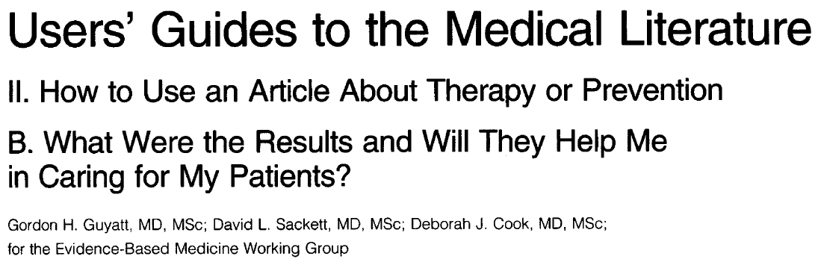
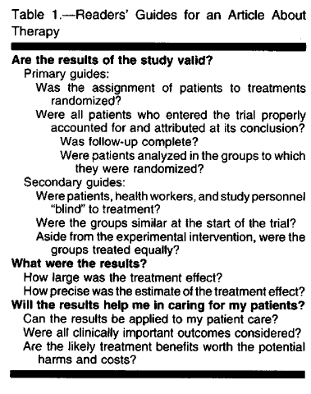
JAMA 1994;271:56

Slide 9
Guideline Development
evidence
+
integration of values
Effect size
Confidence Intervals
Validity
Homogeneity
Adequacy of control group
Biological plausibility
Generalizability
Safety
Feasibility
Cost
practice
guidelines

Slide 10
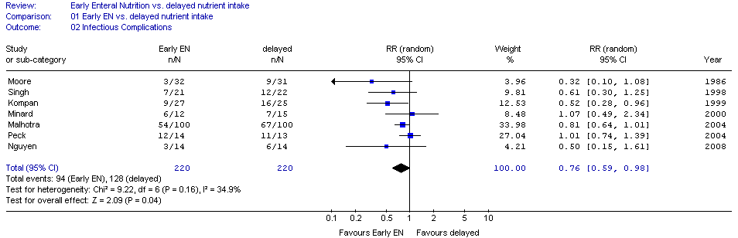
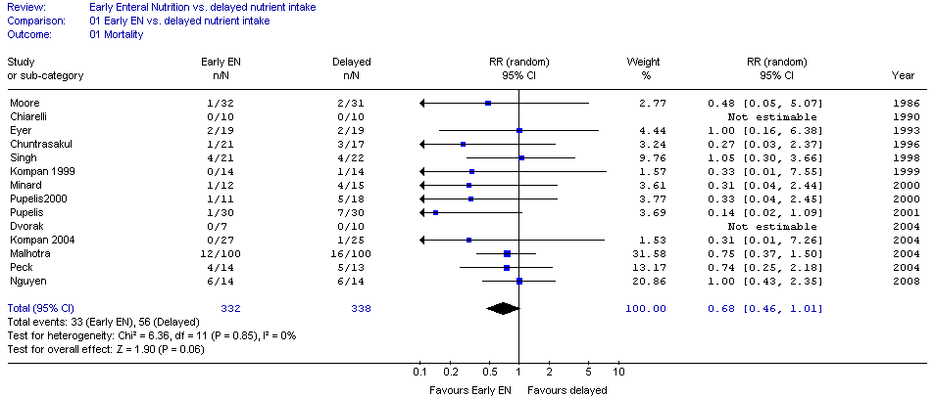

RCTs of Early vs. Delayed EN
Infection
RR 0.76 (0.69, 0.98)
Mortality
RR 0.68 (0.46, 1.01)

Slide 11
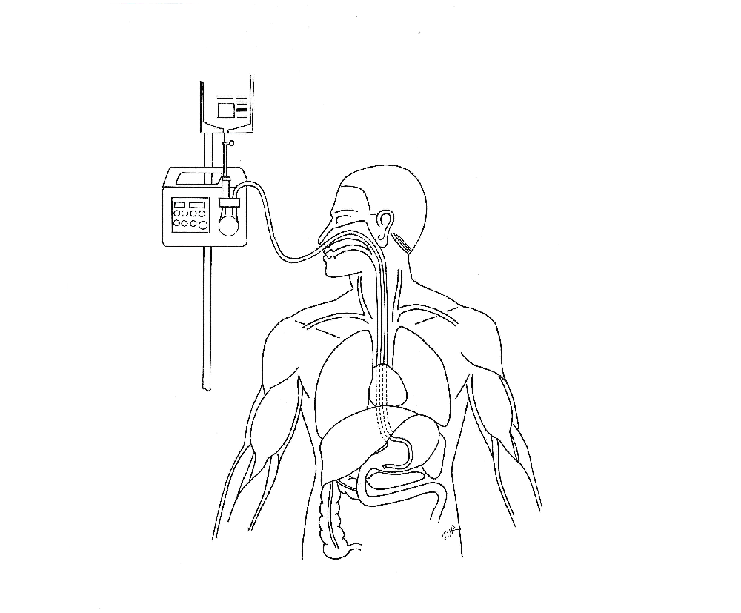
Nutritional and Non-nutritional benefits of Early Enteral Nutrition
Attenuate oxidative stress
↓ Systemic Inflammatory
Response Syndrome (SIRS)
Reduce gut/lung axis of inflammation
Maintain MALT tissue
↑Production of Secretory IgA at
epithelial surfaces
↑Dominance of anti-inflammatory Th2 over
pro-inflammatory Th1 responses
Modulate adhesion molecules to ↓
transendothelial migration of macrophages
and neutrophils
↑ Muscle function, mobility, return
to baseline function
Provide micro & macronutrients, antioxidants
Maintain lean body mass
↓Muscle and tissue glycosylation
↑ Mitochondrial function
↑ Protein synthesis to meet metabolic demand
Maintain gut integrity
↓Gut permeability
Support commensal bacteria
Stimulate oral tolerance
↑Butyrate production
Promote insulin sensitivity,
↓hyperglycemia (AGEs)
↑ Absorptive capacity
Influence anti-inflammatory receptors
in GI tract
↓ Virulence of pathogenic organisms
↑ Motility, contractility

Slide 12
What About Feeding the Hypotensive Patient?
Resuscitation is the priority
No sense in feeding someone dying of
progressive circulatory failure
However, if resuscitated yet remaining
on vasopressors:
Safety and Efficacy of EN??

Slide 13
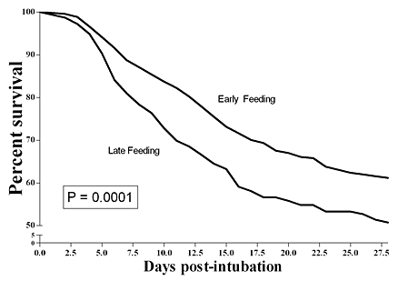
Feeding the Hypotensive Patient?
Prospectively collected multi-institutional ICU database of 1,174 patients who required mechanical ventilation for more than two days and were on vasopressor agents to support blood pressure.
The beneficial effect of early feeding is more evident in
the sickest patients, i.e., those on multiple vasopressor agents.
Khalid I, et al. Am J Crit Care. 2010;19(3):261-8.

Slide 14
Pragmatic RCT in 33 ICUs in England
2400 patients expected to require nutrition support for at least 2 days after unplanned admission
Early EN vs Early PN
According to local products and policies
Powered to detect a 6.4% ARR in 30 day mortality
NEJM Oct 1 2014

Slide 15
No difference in 30 day or 90 day mortality or infection nor 14 other secondary outcomes
Suboptimal method of determining infection
Protein Delivered: EN 0.7 gm/kg; PN 1.0 gm/kg
Notes:
Relied on micro data plus antibiotics, no adjudication or explication how the presence or absence of infection was determined. Reported as number of infections per patient.

Slide 16
CALORIES Trial
Results of Subgroup Analysis on 30 Mortality

Slide 17
Optimal Amount of Protein and Calories for Critically Ill Patients?
Early EN (within 24-48 hrs of admission) is recommended!

Slide 18
Increasing Calorie Debt Associated with Worse Outcomes
Caloric Debt
Adequacy of EN
↑ Caloric debt associated with:
  ↑ Longer ICU stay
  ↑ Days on mechanical ventilation
  ↑ Complications
  ↑ Mortality
Rubinson CCM 2004; Villet Clin Nutr 2005; Dvir Clin Nutr 2006; Petros Clin Nutr 2006

Slide 19
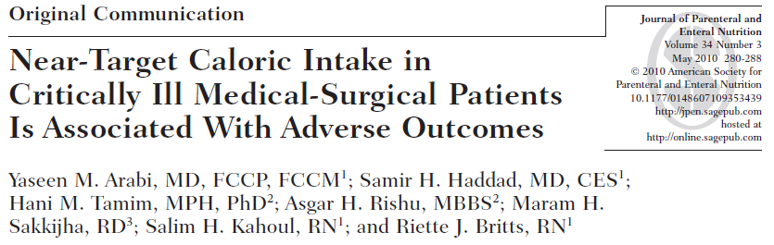
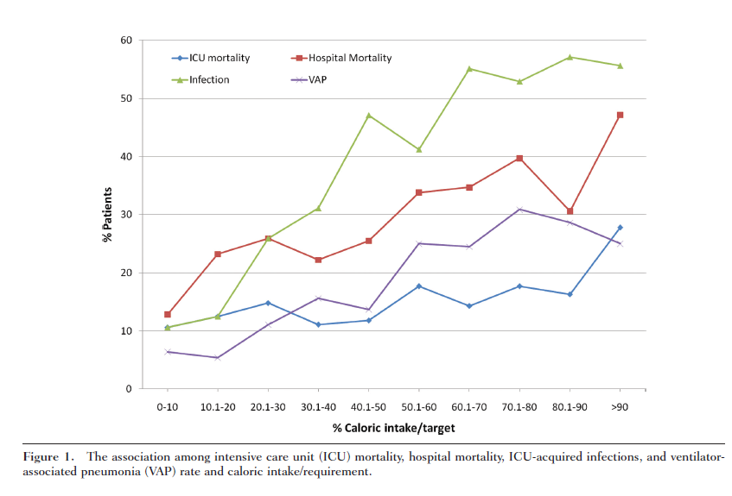

Slide 20
Optimal Amount of Calories for Critically ill Patients:
Depends on How You Slice the Cake!
Objective: To examine the relationship between the amount of calories received and mortality using various sample restriction and statistical adjustment techniques and demonstrate the influence of the analytic approach on the results.
Design: Prospective, multi-institutional audit
Setting: 352 Intensive Care Units (ICUs) from 33 countries.
Patients: 7,872 mechanically ventilated, critically ill patients who remained in ICU for at least 96 hours.
Heyland Crit Care Med 2011

Slide 21
Association between 12 day average caloric adequacy and
60 day hospital mortality
(Comparing patients who received>2/3 to those who received<1/3)
A. In ICU for at least 96 hours. Days after permanent progression to exclusive oral feeding are included as zero calories*
B. In ICU for at least 96 hours. Days after permanent progression to exclusive oral feeding are excluded from average adequacy calculation.*
C. In ICU for at least 4 days before permanent progression to exclusive oral feeding. Days after permanent progression to exclusive oral feeding are excluded from average adequacy calculation.*
D. In ICU at least 12 days prior to permanent progression to exclusive oral feeding*
*Adjusted for evaluable days and covariates, covariates include region (Canada, Australia and New Zealand, USA, Europe and South Africa, Latin America, Asia), admission category (medical, surgical), APACHE II score, age, gender and BMI.
Notes:
Remove the 1/3-2/3 data

Slide 22
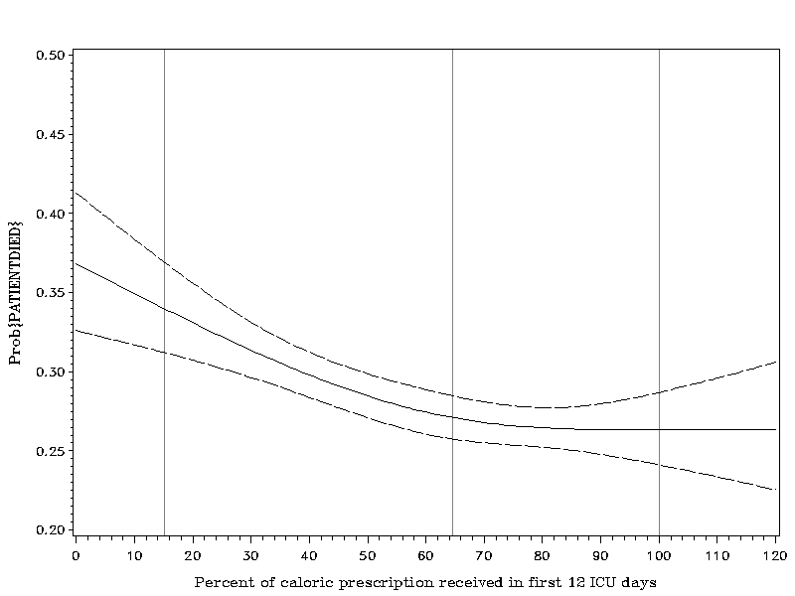
Association Between 12-day Nutritional Adequacy and 60-Day Hospital Mortality
Optimal amount=
80-85%
Heyland CCM 2011

Slide 23
Impact of Protein Intake on 60-Day Mortality
Impact of Protein Intake on 60-day Mortality
Data from 2828 patients from 2013 International Nutrition Survey
 | Patients in ICU ≥ 4 d
Variable | 60-Day Mortality, Odds Ratio (95% CI)
 | Adjusted¹ | Adjusted²
Protein Intake (Delivery > 80% of prescribed vs. < 80%) | 0.61 (0.47, 0.818) | 0.66 (0.50, 0.88)
Energy Intake (Delivery > 80% vs. < 80% of Prescribed) | 0.71 (0.56, 0.89) | 0.88 (0.70, 1.11)
¹ Adjusted for BMI, Gender, Admission Type, Age, Evaluable Days, APACHE II Score, SOFA Score
² Adjusted for all in model 1 plus for calories and protein
Nicolo, Heyland (in submission)

Slide 24
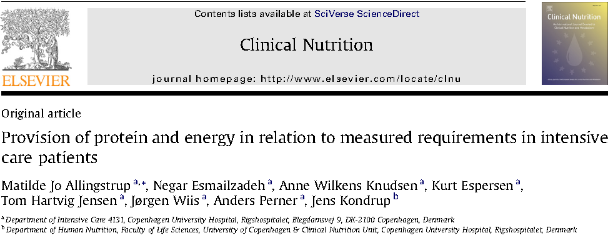
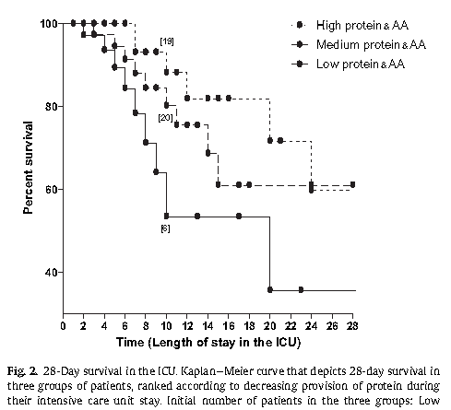
113 select ICU patients with sepsis or burns
On average, receiving 1900 kcal/day and 84 grams of protein
No significant relationship with energy intake but……
Clinical Nutrition 2012

Slide 25
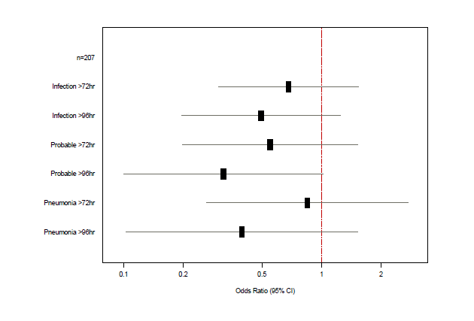
Effect of Increasing Amounts of Protein from EN on Infectious Complications
Multicenter observational study of 207 patients >72 hrs in ICU followed prospectively for development of infection
for increase of 30 grams/day, OR of infection at 28 days
Heyland Clinical Nutrition 2010

Slide 26
Nutritional Adequacy and Long-term Outcomes in Critically ill Patients Requiring Prolonged Mechanical Ventilation
Sub study of the REDOXS study
302 patients survived to 6-months follow-up and were mechanically ventilated for more than eight days in the intensive care unit were included.
Nutritional adequacy was obtained from the average proportion of prescribed calories received during the first eight days of mechanical ventilation in the ICU.
HRQoL was prospectively assessed using Short-Form 36 Health Survey (SF-36) questionnaire at three-months and six-months post ICU admission.

Slide 27
Estimates of Association Between Nutritional Adequacy and SF-36 Scores
SF-36 |  | Adjusted Estimate* (95% CI) | p-value
Physical Functioning | 3-month (n=179) | 7.29 (1.43, 13.15) | 0.02
 | 6-month (n=202) | 4.16 (-1.32, 9.64) | 0.14
Role Physical | 3-month (n=178) | 8.30 (2.65, 13.95) | 0.004
 | 6-month (n=202) | 3.15 (-2.25, 8.54) | 0.25
Physical Component Scale | 3-month (n=175) | 1.82 (-0.18, 3.81) | 0.07
 | 6-month (n=200) | 1.33 (-0.65, 3.31) | 0.19
*Every 25% increase in nutritional adequacy; adjusted for age, APACHE II score, baseline SOFA, Functional Comorbidity Index, admission category, primary ICU diagnosis, body mass index, and region

Slide 28

Trophic vs. Full Enteral Feeding in Critically ill Patients With Acute Respiratory Failure
“survivors who received initial full-energy enteral nutrition were more likely to be discharged home with or without help as compared to a rehabilitation facility (68.3% for the full-energy group vs. 51.3% for the trophic group; p = .04).”
Rice CCM 2011;39:967

Slide 29
RCT Level of Evidence that More EN = Improved Outcomes
RCTs of aggressive feeding protocols
  Results in better protein-energy intake
  Associated with reduced complications and improved survival
Meta-analysis of Early vs Delayed EN
  Reduced infections: RR 0.76 (.59,0.98),p=0.04
  Reduced Mortality: RR 0.68 (0.46, 1.01) p=0.06
  Taylor et al Crit Care Med 1999; Martin CMAJ 2004
  www.criticalcarenutrition.com

Slide 30

Optimal Nutrition (>80%)
Is Better!
Earlier and
If you feed them (better!)
They will leave (sooner!)

Slide 31
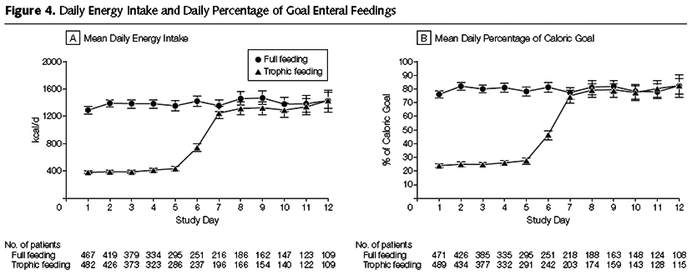
Initial Tropic vs. Full EN in Patients with Acute Lung Injury
The EDEN randomized trial
Rice TW, et al. JAMA. 2012;307(8):795-803.

Slide 32
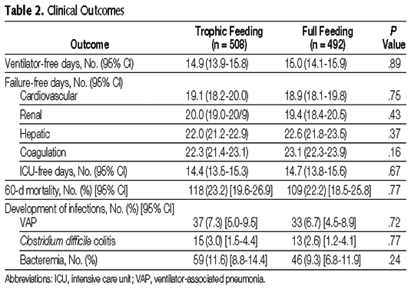
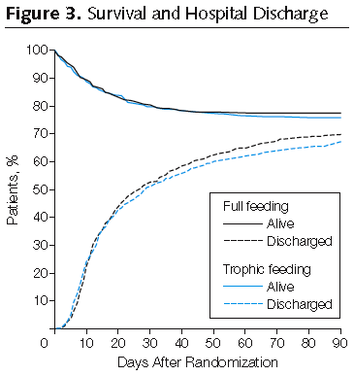
Initial Tropic vs. Full EN in Patients with Acute Lung Injury
The EDEN randomized trial
Rice TW, et al. JAMA. 2012;307(8):795-803.

Slide 33
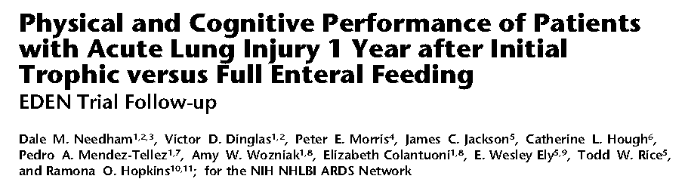
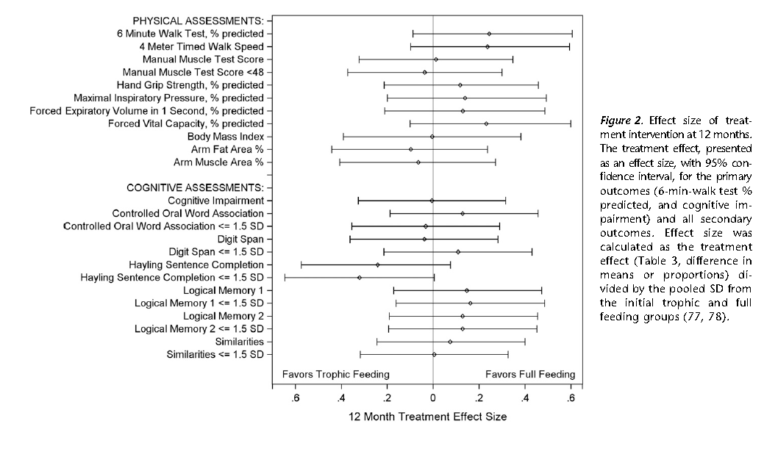
Are the benefits of trophic feeds (none) worth the risk of harm?

Slide 34
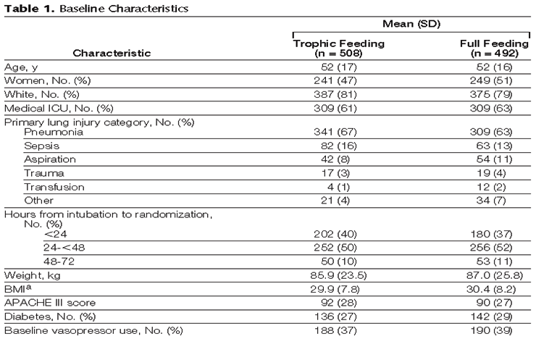
Initial Tropic vs. Full EN in Patients with Acute Lung Injury
The EDEN randomized trial
Enrolled 12% of patients screened
Rice TW, et al. JAMA. 2012;307(8):795-803.

Slide 35
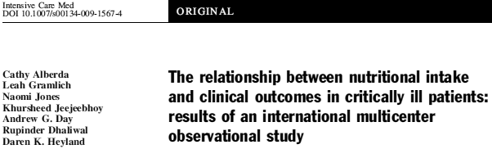
Trophic vs. Full EN in Critically ill Patients with Acute Respiratory Failure
Average age 52
Few comorbidities
Average BMI* 29-30
All fed within 24 hours (benefits of early EN)
Average duration of study intervention 5 days
No effect in young, healthy,
overweight patients who have short stays!
* BMI: body mass index
Alberda C, et al. Intensive Care Med. 2009;35(10):1728-37.

Slide 36
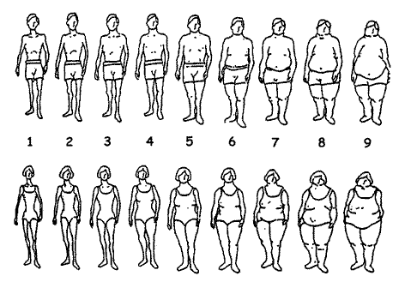
ICU Patients Are Not All Created Equal…Should We Expect the Impact of Nutrition Therapy to be the Same Across All Patients?

Slide 37
Not All ICU Patients Are the Same!
Low Risk
High Risk
  34 year old former football player
  BMI 35
  Otherwise healthy
  Involved in motor vehicle accident
  Mild head injury and fractured R leg requiring ORIF
  79 year old woman
  BMI 35
  PMHx COPD, poor functional status, frail
  Admitted to hospital 1 week ago with CAP
  Now presents in respiratory failure requiring intubation and ICU admission

Slide 38

How Do We Figure Out Who Will Benefit the Most from Nutrition Therapy?
Notes:
Need picture of malnourshed child

Slide 39
A Conceptual Model for Nutrition Risk Assessment in the Critically ill
Acute
Reduced po intake
pre ICU hospital stay
Acute
Reduced po intake
pre ICU hospital stay
Acute
Reduced po intake
pre ICU hospital stay
Chronic
Recent weight loss
BMI?
Chronic
Recent weight loss
BMI?
Chronic
Recent weight loss
BMI?
Starvation
Starvation
Starvation
Nutrition Status
micronutrient levels - immune markers - muscle mass
Inflammation
Acute
IL-6
CRP
PCT
Chronic
Comorbid illness

Slide 40
The Development of the NUTrition Risk in the Critically ill Score (NUTRIC Score).
Variable | Range | Points
Age | <50 | 0
 | 50-<75 | 1
 | >=75 | 2
APACHE II | <15 | 0
 | 15-<20 | 1
 | 20-28 | 2
 | >=28 | 3
SOFA | <6 | 0
 | 6-<10 | 1
 | >=10 | 2
# Comorbidities | 0-1 | 0
 | 2+ | 1
Days from hospital to ICU admit | 0-<1 | 0
 | 1+ | 1
IL6 | 0-<400 | 0
 | 400+ | 1
AUC | 0.783
Gen R-Squared | 0.169
Gen Max-rescaled R-Squared | 0.256
BMI, CRP, PCT, weight loss, and oral intake were excluded because they were not significantly associated with mortality or their inclusion did not improve the fit of the final model.

Slide 41
The Validation of the NUTrition Risk in the Critically ill Score (NUTRIC Score).
Interaction between NUTRIC Score and nutritional adequacy (n=211)*
P value for the interaction=0.01
Heyland Critical Care 2011, 15:R28

Slide 42
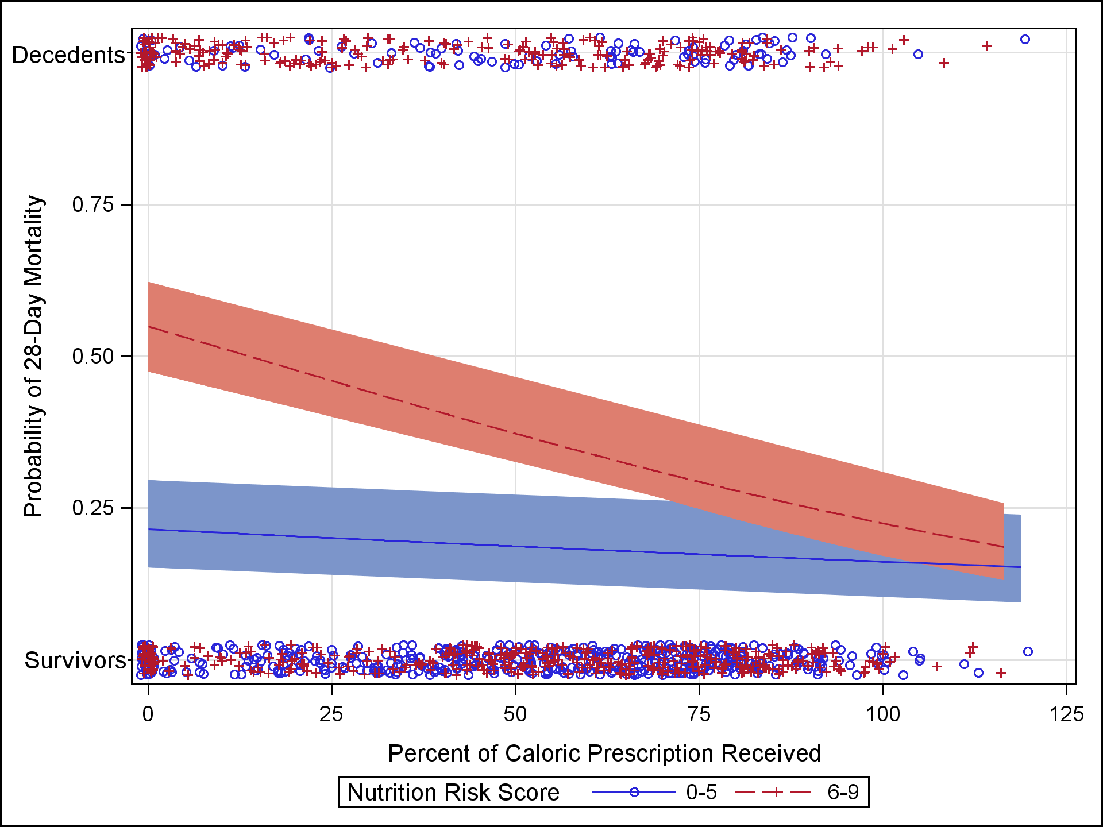
Further Validation of the “Modified NUTRIC” Nutritional Risk Assessment Tool
In a second data set of 1200 ICU patients
Minus IL-6 levels
Rahman Clinical Nutrition 2015 (in press)

Slide 43
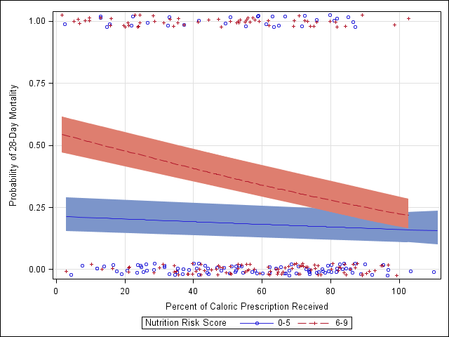
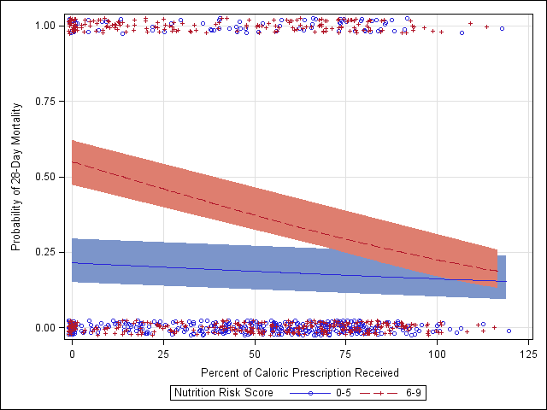
Further Validation of the “Modified NUTRIC”
Nutritional Risk Assessment Tool
Panel A: Among 277 patients who had at least one interruption of EN due to intolerance
Panel B: Among 922 patients who never discontinued EN due to intolerance
Rahman (in submission)

Slide 44
Who Might Benefit the Most From Nutrition Therapy?
High NUTRIC Score?
Clinical
  BMI
  Projected long length of stay
Nutritional history variables
Sarcopenia
Medical vs. Surgical
Others?

Slide 45
Optimal Nutrition (>80%) is Better!
Earlier and
(For High Risk Patients)
If you feed them (better!)
They will leave (sooner!)

Slide 46

Health Care Associated Malnutrition
What if you can’t provide adequate nutrition enterally?
… to add PN or not to add PN,
that is the question!

Slide 47
Early vs. Late Parenteral Nutrition in Critically ill Adults
4620 critically ill patients
Randomized to early PN
  Rec’d 20% glucose 20 ml/hr then PN on day 3
OR late PN
  D5W IV then PN on day 8
All patients standard EN plus ‘tight’ glycemic control
Results:
Late PN associated with
  6.3% likelihood of early discharge alive from ICU and hospital
  Shorter ICU length of stay (3 vs 4 days)
  Fewer infections (22.8 vs 26.2 %)
  No mortality difference
Cesaer NEJM 2011

Slide 48
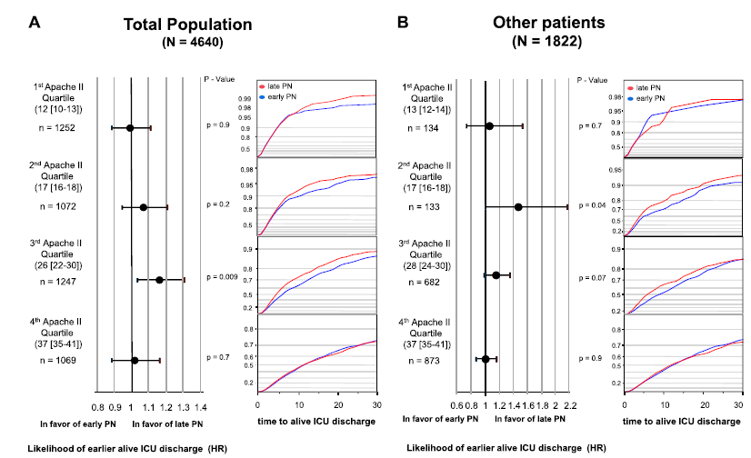
Early Nutrition in the ICU: Less is More!
Post-hoc analysis of EPANIC
Treatment effect persisted in all subgroups
Casaer Am J Respir Crit Care Med 2013;187:247–255

Slide 49
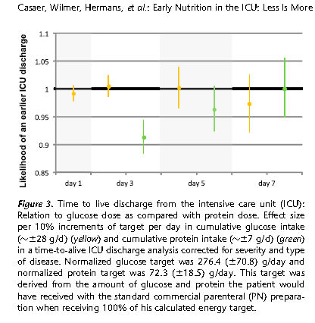
Early Nutrition in the ICU: Less is More!
Post-hoc Analysis of EPANIC
Indication bias:
1) patients with longer projected stay would have been fed more aggressively; hence more protein/calories is associated with longer lengths of stay. (remember this is an unblinded study).
2) 90% of these patients are elective surgery. there would have been little effort to feed them and they would have categorically different outcomes than the longer stay patients in which their were efforts to feed
Protein is the bad guy!!
Casaer Am J Respir Crit Care Med 2013;187:247–255

Slide 50
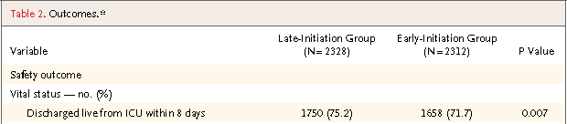


Early vs. Late Parenteral Nutrition in Critically ill Adults
Cesaer NEJM 2011

Slide 51
Early vs. Late Parenteral Nutrition in Critically ill Adults
? Applicability of data
  No one give so much IV glucose in first few days
  No one practice tight glycemic control
Right patient population?
  Majority (90%) surgical patients (mostly cardiac-60%)
  Short stay in ICU (3-4 days)
  Low mortality (8% ICU, 11% hospital)
  >70% normal to slightly overweight
Not an indictment of PN
  Clear separation of groups after 2-3 days
  Early group only rec’d PN on day 3 for 1-2 days on average
  Late group –only ¼ received any PN
Cesaer NEJM 2011

Slide 52
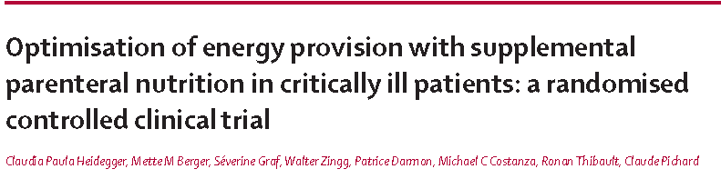

Lancet Dec 2012
Doig, ANZICS, JAMA May 2013

Slide 53
What if you can’t provide adequate nutrition enterally?
… to TPN or not to TPN,
that is the question!
Case by case decision
Maximize EN delivery prior to initiating PN
Use early in high risk cases

Slide 54
Start PEPuP within 24-48 hrs
At 72 hrs >80% of Goal Calories?
Yes
No
High Risk?
Carry on!
No
Yes
Maximize EN with motility agents and small bowel feeding
No problem
Tolerating EN at 96 hrs?
Yes
No
Supplemental PN?
No problem

Slide 55
In Conclusion
A moderate amount of moderate quality of evidence informs current critical care nutrition guidelines
  Early EN
  Optimal amount, either EN or PN
  Nutritional risk (NUTRIC Score)
  Trophic feeds may be harmful in delaying recovery of all patients and may be harmful in high nutritional risk patients

